Slide 1

Introduction to Networking and Networking Concepts
Chapter 1
420-A32 Networks

Slide 2
What is a Network?
Something resembling an openwork fabric or structure in form or concept, especially:
A system of lines or channels that interconnect a group
A complex, interconnected group or system
An extended group of people with similar interests or concerns who interact and remain in informal contact for mutual assistance or support
A system of electric components and connecting circuitry designed to function in a specific manner.
A system of computers interconnected by wires or other means in order to share information.

Slide 3
What is Computer Networking?
Connecting computers and other electronic devices together
A great deal of technology is required for one device to connect and communicate with another, and many choices for physical connections and related software are possible
An elementary network consists of two computers connected by some kind of transmission medium

Slide 4
Why Use Networks?
To share data and to communicate quickly and efficiently
Sharing enables users to exchange information and route data between them as workflow demands
Can improve human communication substantially
Peripheral device sharing enables users to take advantage of peripherals and other devices attached directly to a network or to a generally available computer attached to a network

Slide 5
Why Use Networks?
Network admin can centrally control the network and the clients on it
Security is enhanced and more easily controlled:
Users can be assigned different privileges depending on their job function.
Security of files more easily controlled than if they are kept on the client systems distributed all over the network.
Network restricts access to unwanted users and hackers.

Slide 6
Why Use Networks?
Programs can be located on the network and shared by all the users.
This makes it easier to ensure all users are using the same version of the software.
Updating the software is easier and cheaper
Users can share the programs data files which allows them to participate in group work even at great distances.
Data backup and restore much easier than if the files are distributed on the client machines.

Slide 7
Why Use Networks?
Devices can be shared on the network meaning:
Fewer devices are required
Users have access to better devices than they could afford individual
Services of devices can be more centrally located
Updating of devices and device drivers more easily maintained

Slide 8
Network Medium
To communicate successfully, computers must share access to a common network medium
Its job is to carry the signals one computer sends to one or more other computers
Computers must attach to the network medium by using some kind of physical interface
Network interface card (NIC) or network adapter
For large-scale networks, multiple media usually work together (interoperate) across the total networking environment

Slide 9
Network Protocol
Network protocol: common set of rules that allows two computers on a network to communicate with one another successfully
How to interpret signals, how to identify a computer on a network, how to initiate and end networked communications, and how to manage information exchange across the network medium
Examples:
TCP/IP
NetBEUI
IPX/SPX

Slide 10
Network Software
Computers need network software to issue the requests and responses that let them take the roles of clients and servers
Network operating system (NOS): determines what services that computer can offer or request
Controls access to network services and network resources a computer makes available to clients
With today’s operating systems, the line between a client and a server has become blurred
However, most operating systems have a workstation version and a server version.

Slide 11
Network Services
Sharing resources and communication requires two components:
server component that provides access to resource
client component that requests access to resource
Both components are referred to as a service
NOSs must be outfitted with the types of services your client operating systems require
web servers
e-mail servers
file and print servers

Slide 12
Common Network Elements
Client
Network computer requesting resources or services from another network computer
Client workstation human user
Client software installed on workstation
Server
Network computer managing shared resources
Runs network operating system
Workstation
Personal computer
May or may not be connected to network

Slide 13
Common Network Elements
NIC (network interface card)
Device inside computer
Connects computer to network media
Allows communication with other computers

Slide 14
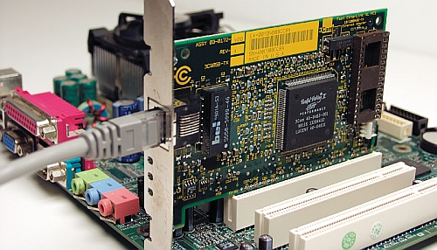
Network Interface Card (NIC)

Slide 15
Terminology
Host
Computer
Enables network resource sharing by other computers
Node
Client, server, or other device
Communicates over a network
Identified by unique number (network address)
Connectivity device
Allows multiple networks or multiple parts of one network to connect and exchange data

Slide 16
Terminology
Segment
Group of nodes
Use same communications channel for traffic
Backbone
Connects segments and significant shared devices
“A network of networks”
Topology
Computer network physical layout
Ring, bus, star or hybrid formation

Slide 17
Common Network Terms
Protocol
Standard method or format for communication between networked devices
Data packets
Distinct data units exchanged between nodes
Addressing
Scheme for assigning unique identifying number to every node
Transmission media
Means through which data is transmitted and received

Slide 18
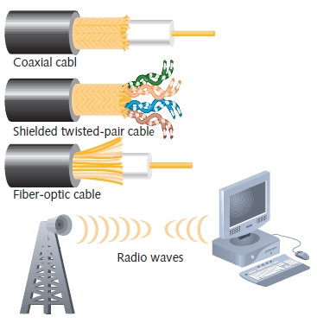
Transmission Media

Slide 19
How Networks Are Used
Network services
Functions provided by a network
Most visible one is e-mail
Other vital services
Printer sharing
File sharing
Internet access and Web site delivery
remote access capabilities
provision of voice (telephone) and video services
network management

Slide 20
File and Print Services
File services
Capability of server to share data files, applications and disk storage space
File server
Provides file services
File services provide foundation of networking
Print services
Share printers across network
Saves time and money

Slide 21
Access Services
Allow remote user network connection
Allow network users to connect to machines outside the network
Remote user is a computer user on different network or in different geographical location
Network operating systems include built-in access services
Allow external users to use network resources and devices
Same as if logged on to office workstation

Slide 22
Communications Services
Convergence
Phenomenon of offering multiple types of communications services on the same network
Unified communications
Multiple network-based communications centralized management
E-mail
Oldest and most frequently used
Mail server
Computer responsible for mail services
Coordinates storage and transfer of e-mail

Slide 23
Communications Services
Additional tasks of mail servers
Intercept spam
Handle objectionable content
Route messages according to rules
Provide Web-based client
Notify administrators or users if certain events occur
Schedule e-mail transmission, retrieval, storage, maintenance functions
Communicate with mail servers on other networks
Mail server runs specialized mail server software

Slide 24
Internet Services
Supplying Web pages
Servers work together to bring Web pages to user’s desktop
Web server
Computer installed with appropriate software to supply Web pages to many different clients upon demand
Other Internet services
File transfer capabilities, Internet addressing schemes, security filters, means for directly logging on to other Internet computers

Slide 25
Management Services
Small network management
Single network administrator
Network operating system’s internal functions
Today’s larger network management
Centrally administered network management tasks

Slide 26
Management Services
Other important services
Traffic monitoring and control
Load balancing
Hardware diagnosis and failure alert
Asset management
License tracking
Security auditing
Address management
Backup and restoration of data

Slide 27
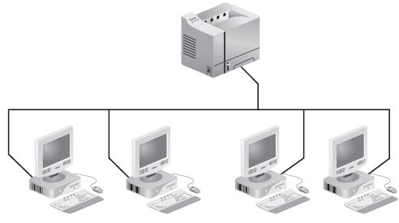
A Simple Network

Slide 28
Understanding Network Types
Networks fall into two major types: peer-to-peer and client/server (also called server-based)
This discussion of network types addresses the roles that computers play on the network and how those roles interact
Client/server networks are the most typical and represent the primary focus of the discussion here
Understanding both types is essential, especially as they compare with one another

Slide 29
Peer-to-Peer Networks
In a peer-to-peer network, every user must also act as a network administrator, controlling access to the resources on their machines
Because of this flexibility, institutionalized chaos is the norm for peer-to-peer networks
Security can be a major concern
Computers can be affiliated into loose federations called workgroups, but no network-wide security can be enforced
As the number of users and resources grows, these networks can become unworkable

Slide 30
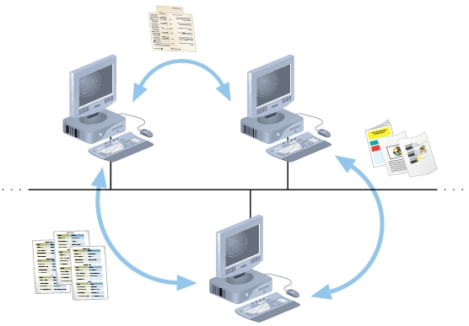
Peer-to-Peer Networks
Resource sharing on a simple peer-to-peer network

Slide 31
Peer-to-Peer Networks

Slide 32
Peer-to-Peer Advantages
Easy to install and configure
Machines don’t depend on the presence of a dedicated server
Users control their own shared resources
Inexpensive to purchase and operate
Need no additional equipment or software beyond a suitable operating system
No dedicated administrators are needed
Work best for networks with 10 or fewer users

Slide 33
Peer-to-Peer Disadvantages
Not secure
Users might be forced to use as many passwords as there are shared resources
Each PC must be backed up to protect shared data
When a shared resource is accessed, performance of the PC where the resource resides is reduced
There is no centralized organizational scheme to locate or control access to data
Access to a shared resource is unavailable if PC where resource resides is turned off/crashes
Doesn’t usually work well with more than 10 users

Slide 34
Peer-to-Peer Networks
Resource sharing method
Modify file sharing controls
A user responsibility
Not centrally controlled
Potential variations and security issues
Environments
Small home or office
Large networks using the Internet
Gnutella, Freenet, original Napster
BitTorrent software

Slide 35
Client/Server Networks

Slide 36
Client/Server Networks
Central computer (server)
Facilitates communication and resource sharing
Clients (other computers)
Personal computers
Known as workstations
Central resource sharing controlled by server
Data sharing, data storage space, devices
No direct sharing of client resources

Slide 37
Client/Server Networks
Computer roles
Server
Clients
Run local applications
Store data locally
Use server shared applications, data, devices
Use server as intermediary
Communication
Switches or routers

Slide 38
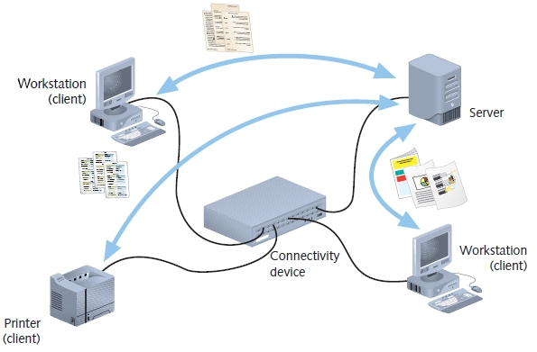
Client/Server Networks
Resource sharing on a client/server network

Slide 39
Client/Server Networks
Server requirement - Network operating system
Manages client data, resources
Ensures authorized user access
Controls user file access
Restricts user network access
Dictates computer communication rules
Supplies application to clients

Slide 40
Client/Server Networks
Server examples
UNIX
Linux
Microsoft Server 2003 and 2008
MAC OS X Server
Server features relative to clients
More memory, processing, storage capacity
Equipped with special hardware
Provides network management functions

Slide 41
Client/Server Advantages
Advantages relative to peer-to-peer networks
Centralized user accounts, security, and access controls simplify network administration
Multiple shared resource access centrally controlled
Central problem monitoring, diagnostics capabilities
More powerful equipment means more efficient access to network resources
User response time optimization capabilities
Efficient processing on large networks
Scalability
Popular in medium- and large-scale organizations

Slide 42
Client/Server Disadvantages
At the worst, server failure renders a network unusable; at the least, it results in loss of network resources
Complex server software requires allocating expert staff, which increases expenses
Dedicated hardware and specialized software add to the cost of server-based networking

Slide 43
The Role of Network Servers
The server is at the heart of any network that’s too large for a peer-to-peer configuration
Most large networks with more than a few dozen workstations rely on several network servers
Your knowledge of a server’s unique hardware requirements and the many roles it can play in a network is essential to being able to design and support today’s computer networks

Slide 44
Application Servers
Application servers supply the server side of client/server applications, and often the data that goes along with them, to network clients
For example, a database server
Differ from basic file and print servers by providing processing services as well as handling requests for file or print services

Slide 45
Communication Servers
Communication servers provide a mechanism for users outside a network to access that network’s resources, and sometimes permit users on a network to access resources outside network’s local scope
Often, installing communication servers on a network enables users who are traveling or working at home to dial in to the network via a modem
In Windows Server 2000/2003: Routing and Remote Access Service (RRAS)

Slide 46
File and Print Servers
File and print servers provide basic network file storage, retrieval services, and access to networked printers
Users can run applications locally but keep data files on the server (and print those files when they want hard copies)
Any Windows, NetWare, or Linux server can act as a file and print server

Slide 47
Mail Servers
Mail servers handle e-mail messages for users
Might involve simply acting as a clearinghouse for local exchange of messages
Also commonly provide “store-and-forward” services
Can store outgoing messages until a connection to an external mail server is established, and then forward messages to their intended destinations
Examples: Microsoft Exchange Server, GroupWise, and Lotus Notes

Slide 48
Web Servers
The World Wide Web is the most well-known aspect of the Internet, made up of documents that can be interlinked by using hyperlinks
Examples: Internet Information Services (IIS), Apache Web server
Apache is the most widely used Web server in the world
Many organizational intranets take advantage of free Web server packages

Slide 49
LANs, MANs, and WANs
LAN (local area network)
Network confined to a relatively small space
1980s
LANs became popular as peer-to-peer based
Today
Larger and more complex client/server network
MAN (metropolitan area network)
Network extends beyond building boundaries
Larger than LAN
Connects clients and servers from multiple buildings

Slide 50
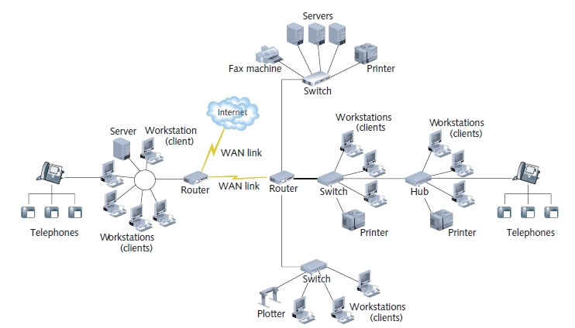
LANs, MANs, and WANs
Figure 1-3 A more complex client/server network

Slide 51
LANs, MANs, and WANs
WAN (wide area network)
Connects two or more geographically distinct LANs or MANs
Comparison to LANs
Use slightly different transmission methods and media
Use greater variety of technologies
Network connection
Separate offices in same organization
Separate offices in different organizations

Slide 52
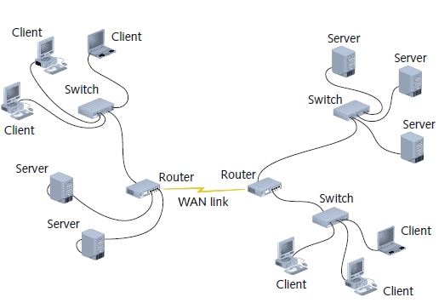
A Simple WAN

Slide 53
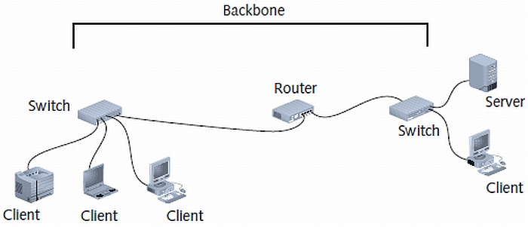
LAN Backbone

Slide 54
Selecting the Right Type of Network
You have a number of choices to make when deciding how to design and implement a network
Will a single LAN do, or is an internetwork required?
Will peer-to-peer networking suffice, or is a server-based network in order?
Do some functions need to be server-based while others work well as a peer-to-peer network?

Slide 55
Choosing a LAN or an Internetwork?
Decision to design a LAN or an internetwork is based on:
How many computers will participate on the network?
Is there a need to tie groups of computers together with network devices such as routers?
Distance the network will span also plays a part in the decision
A LAN is usually called for when:
The number of computers is fewer than 100
Network use and security factors don’t require a router
The network is confined to a single building or floor

Slide 56
Choosing Peer-to-Peer or Client/Server
Choosing peer-to-peer networking exclusively is appropriate only when all the following hold:
The network includes no more than 10 users
All networked machines are close enough to fit within the span of a single LAN
Budget considerations are paramount
No specialized servers are needed

Slide 57
Choosing Peer-to-Peer or Client/Server
A client/server network makes sense when one or more of the following conditions is true:
More than 10 users must share network access
Centralized control, security, resource management, or backup is desirable
Users need access to specialized servers, or they place heavy demands on network resources
An internetwork is in use
Hybrid network uses elements of both a client/server network and a peer-to-peer network

Slide 58
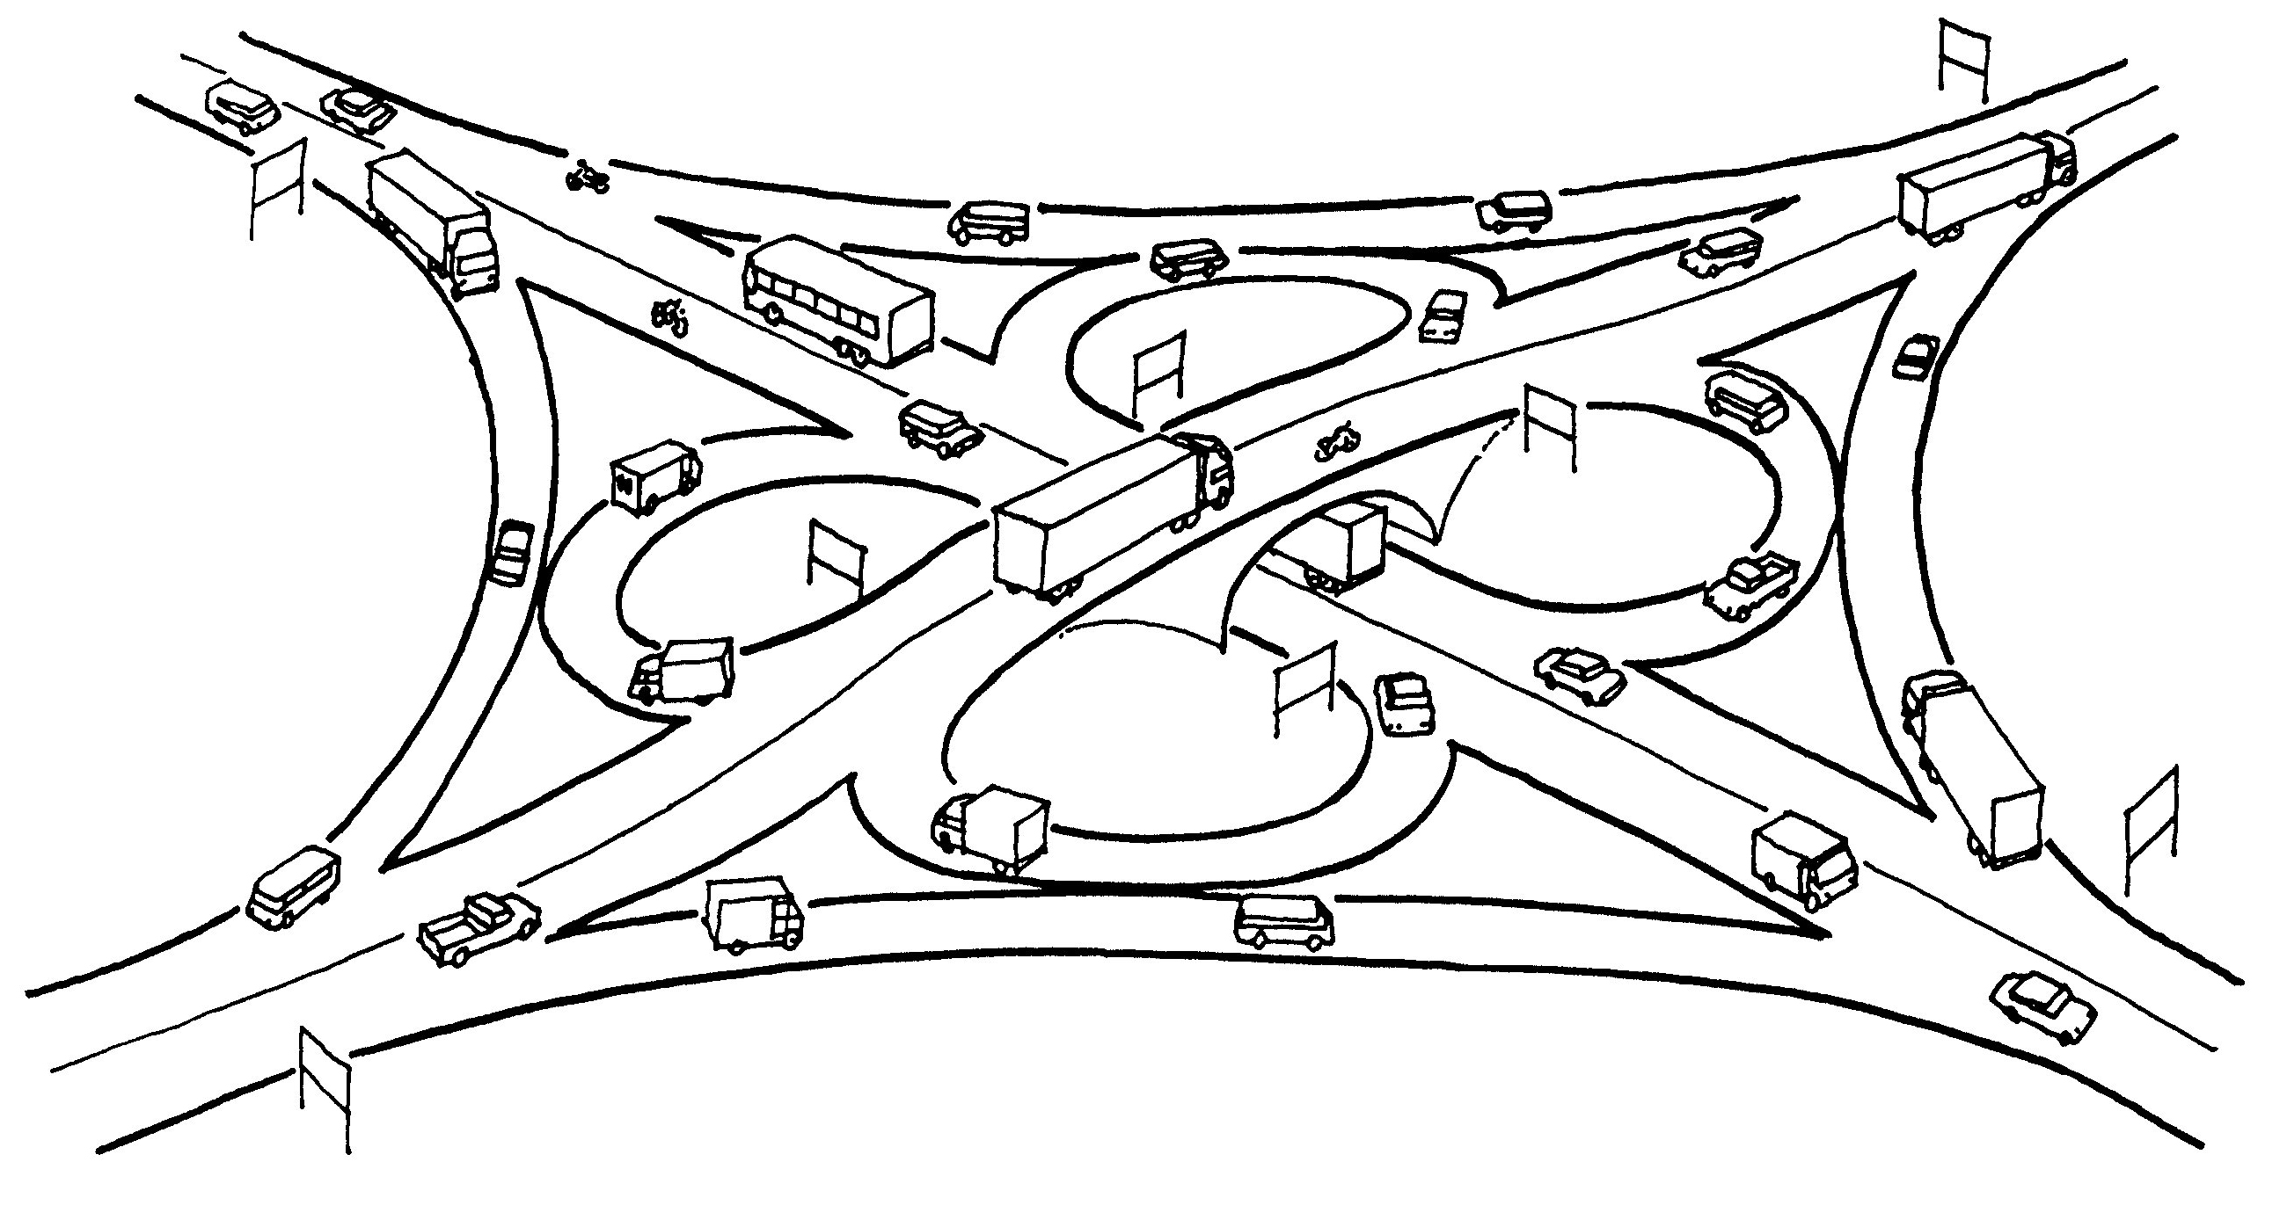
Unintelligent Network
Notes:
Intelligence is in the data that is moving on the network. The data has to know where it is going in order to get to the right spot

Slide 59
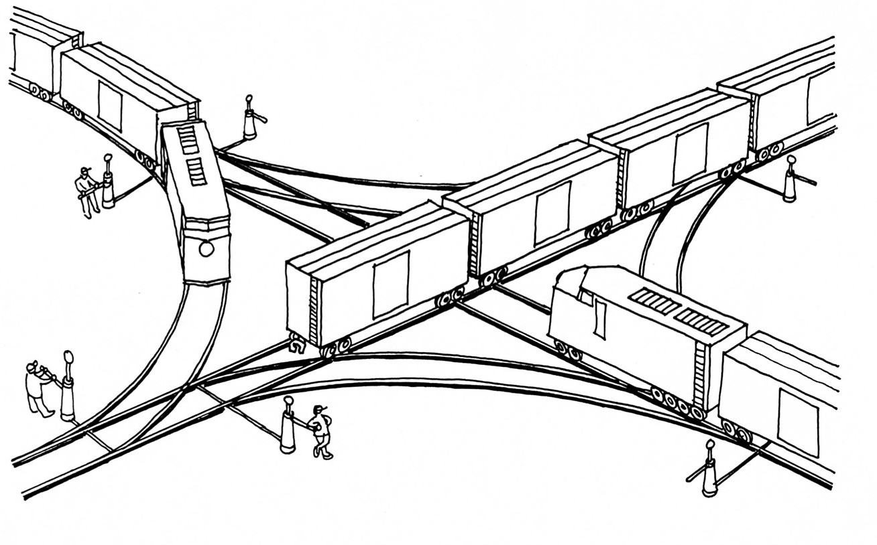
Intelligent Network
Notes:
In an intelligent network parts of the network know where things go and they take care of making sure things go where they are supposed to

